Slide 1
STA10003 FOUNDATIONS OF STATISTICS
Convenor / Lecturer / Tutor
Jascha Zimmermann
jzimmermann@swin.edu.au
CRICOS 00111D TOID 3059
Notes:
You Tube link: http://www.youtube.com/watch?v=lDK9QqIzhwk&ob=av2n
Flick to “Bon Jovi – Livin’ on a prayer” [1986]
Emphasis that song chorus has the words:
Whoa, we're half way there Whoa, livin' on a prayer Take my hand and we'll make it I swear Whoa livin' on a prayer
Congratulate students for being ‘half way there’ – they have attended the lecture
We can be a ‘team’ [joining hands] to get through the unit!
Introduce Self
Before we go any further today, I would like to take this opportunity to acknowledge our Indigenous history …

Slide 2



Indigenous Acknowledgment
Swinburne University of Technology recognises the historical and cultural significance of Australia’s Indigenous history and the role it plays in contemporary education.
Each day, every Australian walks on what was once traditional Indigenous land. I acknowledge the traditional custodians of the land I currently occupy, the Wurundjeri people.
We acknowledge and respect the Traditional Owners of all the lands across Australia, their cultures and heritages. We pay our respects to the Ancestors, Elders past, present and emerging. We recognise the continuing sovereignties of all Aboriginal and Torres Strait Islander Nations.
Notes:
"In recognising the importance of education, Swinburne University also recognises the importance of Australia's Indigenous history and culture to our every day lives. As such, an acknowledgment of traditional custodians is a relevant and important way to connect to that history and culture”.

Slide 3
OVERVIEW
Unit Information / Housekeeping
PAUSE – Part 2
Terminology used in Statistics
Types of Research Methods
Variables and Measurement
Statistical Notation
Order of Operations
PAUSE – Part 3
Critical Thinking in Statistics & Bias

Slide 4
Part 1: Overview
STA10003 Week 1

Slide 5
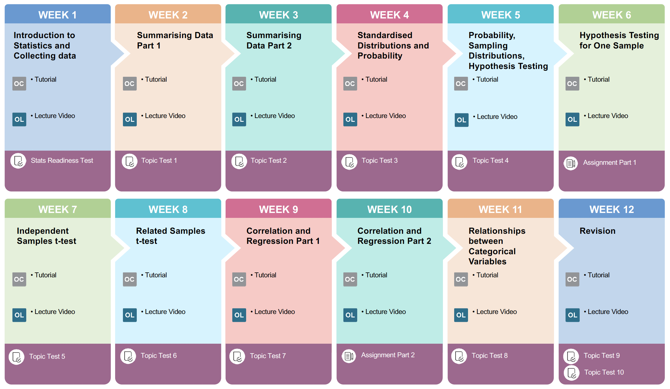
Student Learning Journey Map

Slide 6
Lectures
The lectures are pre-recorded and are available in CANVAS in EchoVideo
It is highly recommended that you watch the lecture PRIOR to attending a Tutorial, as tutorials follow the lecture content.

Slide 7
Tutorials
Tutorials start in Week 1
In the tutorials we cover the practical use of SPSS. We also cover the report writing style that you will need for the assignments.
Attendance will be taken
It is recommended that you check room timetables for the first few weeks of the Semester, as changes may occur.

Slide 8
UNIT INFORMATION / HOUSEKEEPING
STA10003 CANVAS Website
Modules contain Weekly Learning Materials / Assessment information as per the unit outline
Unit Outline
Weekly Schedule of due dates for Topic Tests
STA10003 Text (Suggested)
Gravetter, F. J., & Wallnau, L. B. (2017). Statistics for the Behavioral Sciences (10th ed). Boston: Cengage Learning [text combined with MindTap]
Explore the Canvas site

Slide 9
UNIT INFORMATION / HOUSEKEEPING
IBM SPSS Statistics
All Windows computer in the Library have SPSS installed.
Can be purchased for home use [SPSS v.28 or v.29] SPSS Base Grad Pack from OnTheHub [6 & 12 month rentals] / Hearne Software and the Swinburne [any version from v.25* ok]
Loaded on some computers in labs
SPSS Software mandatory – library and labs have software installed
* Mac Users: version 28 (27 or 26 also fine)

Slide 10
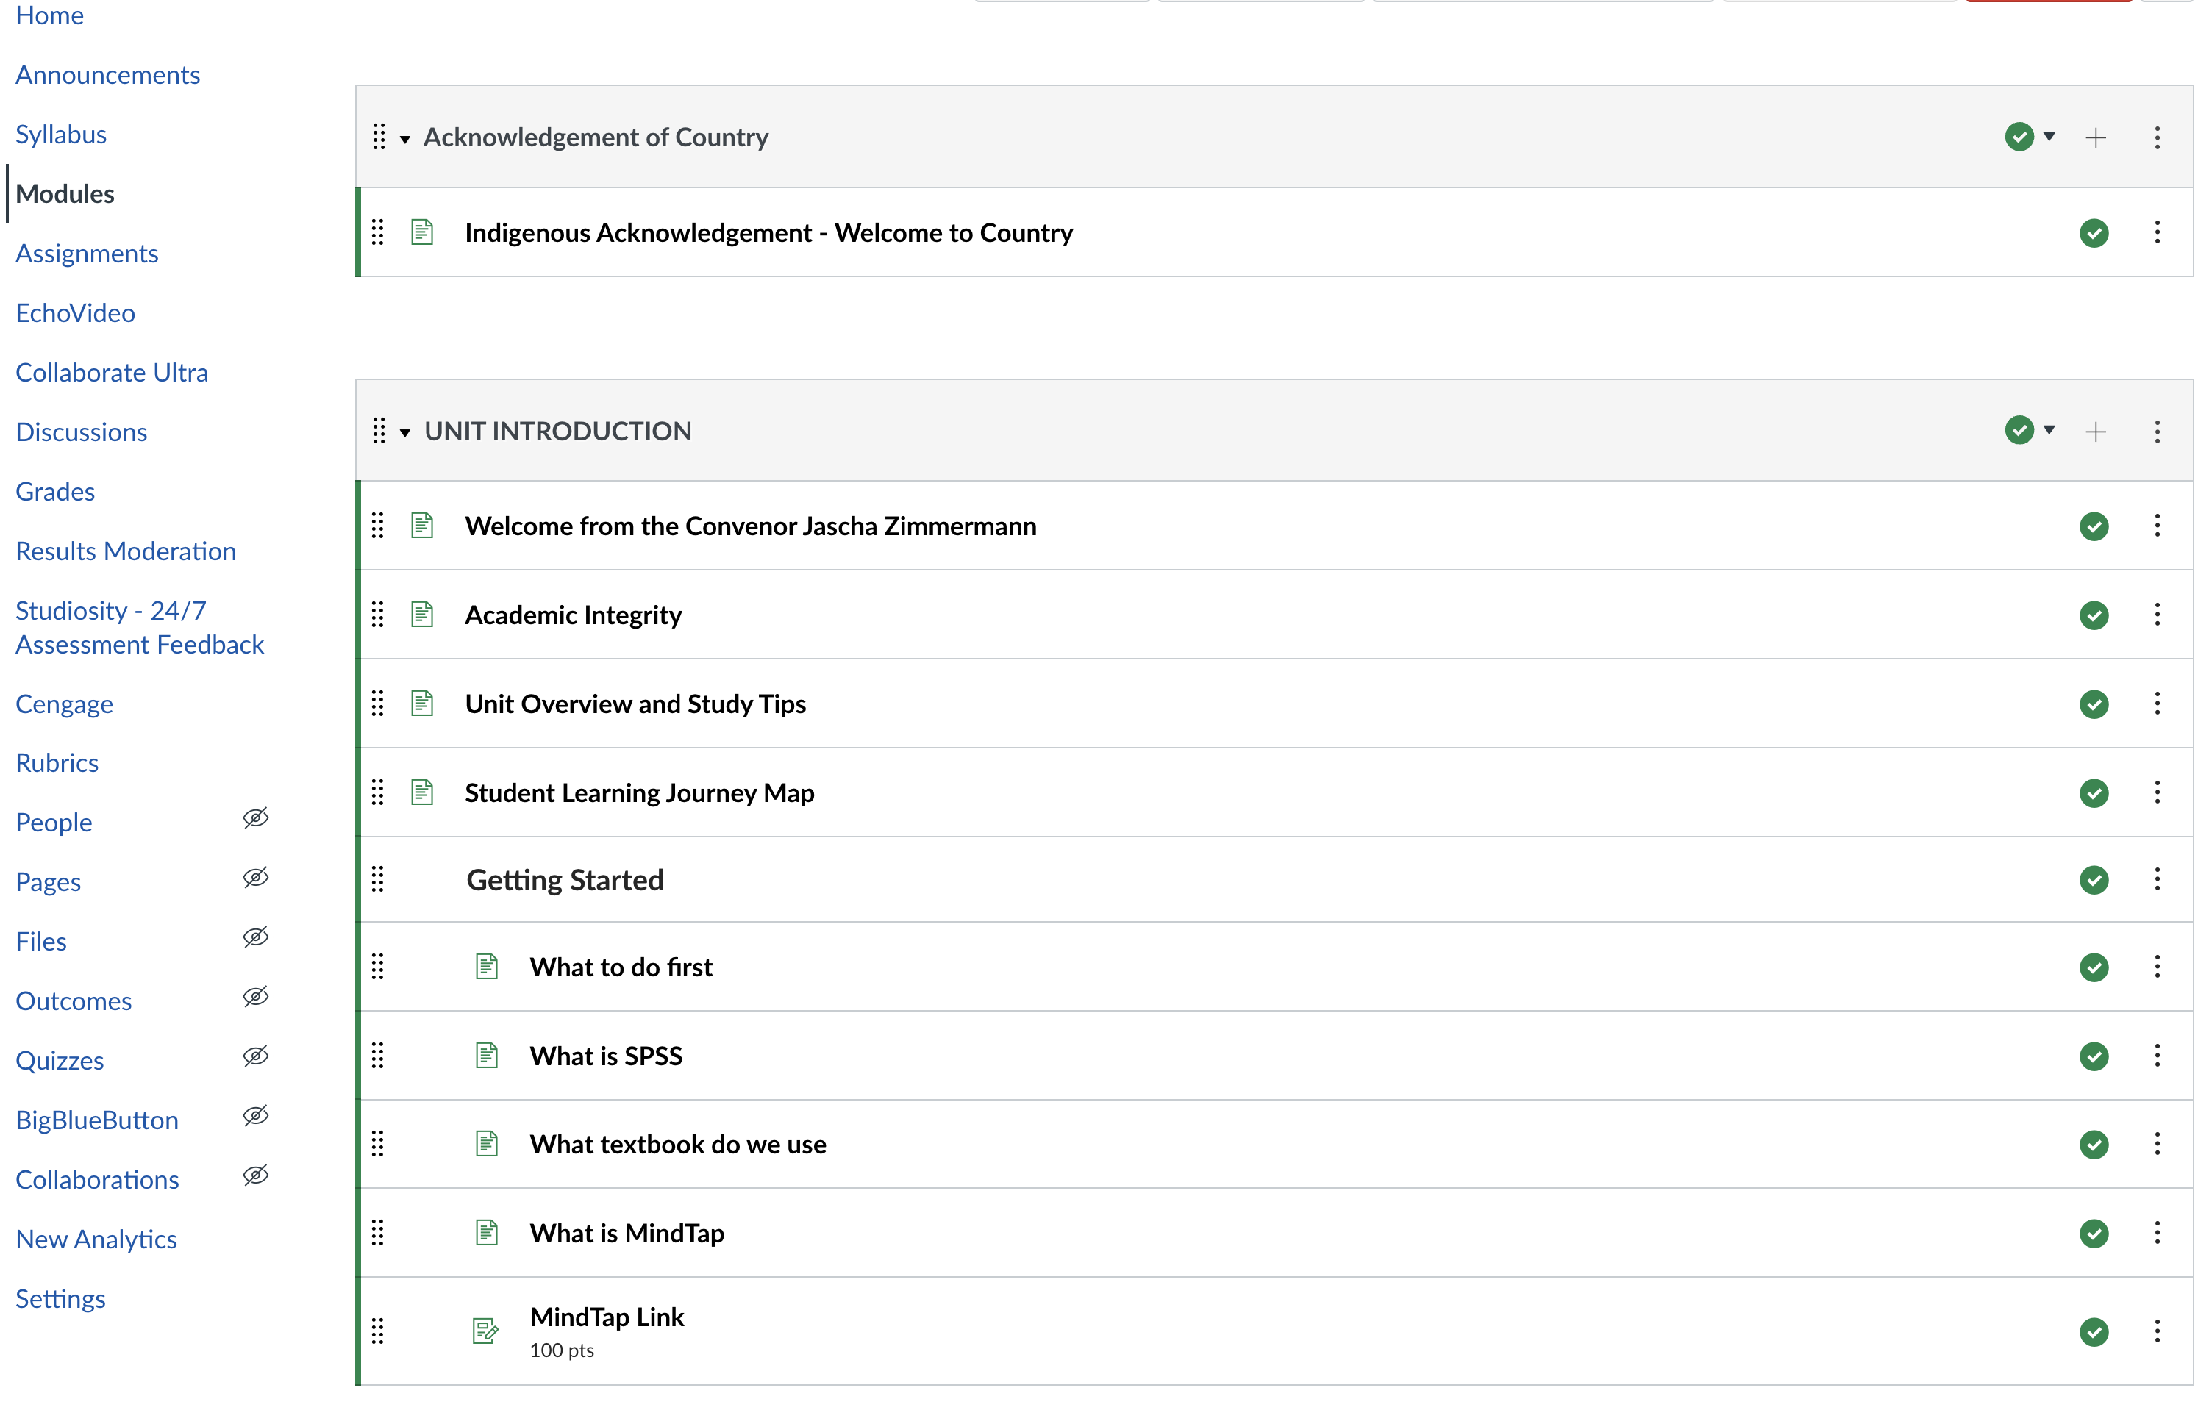

Slide 11
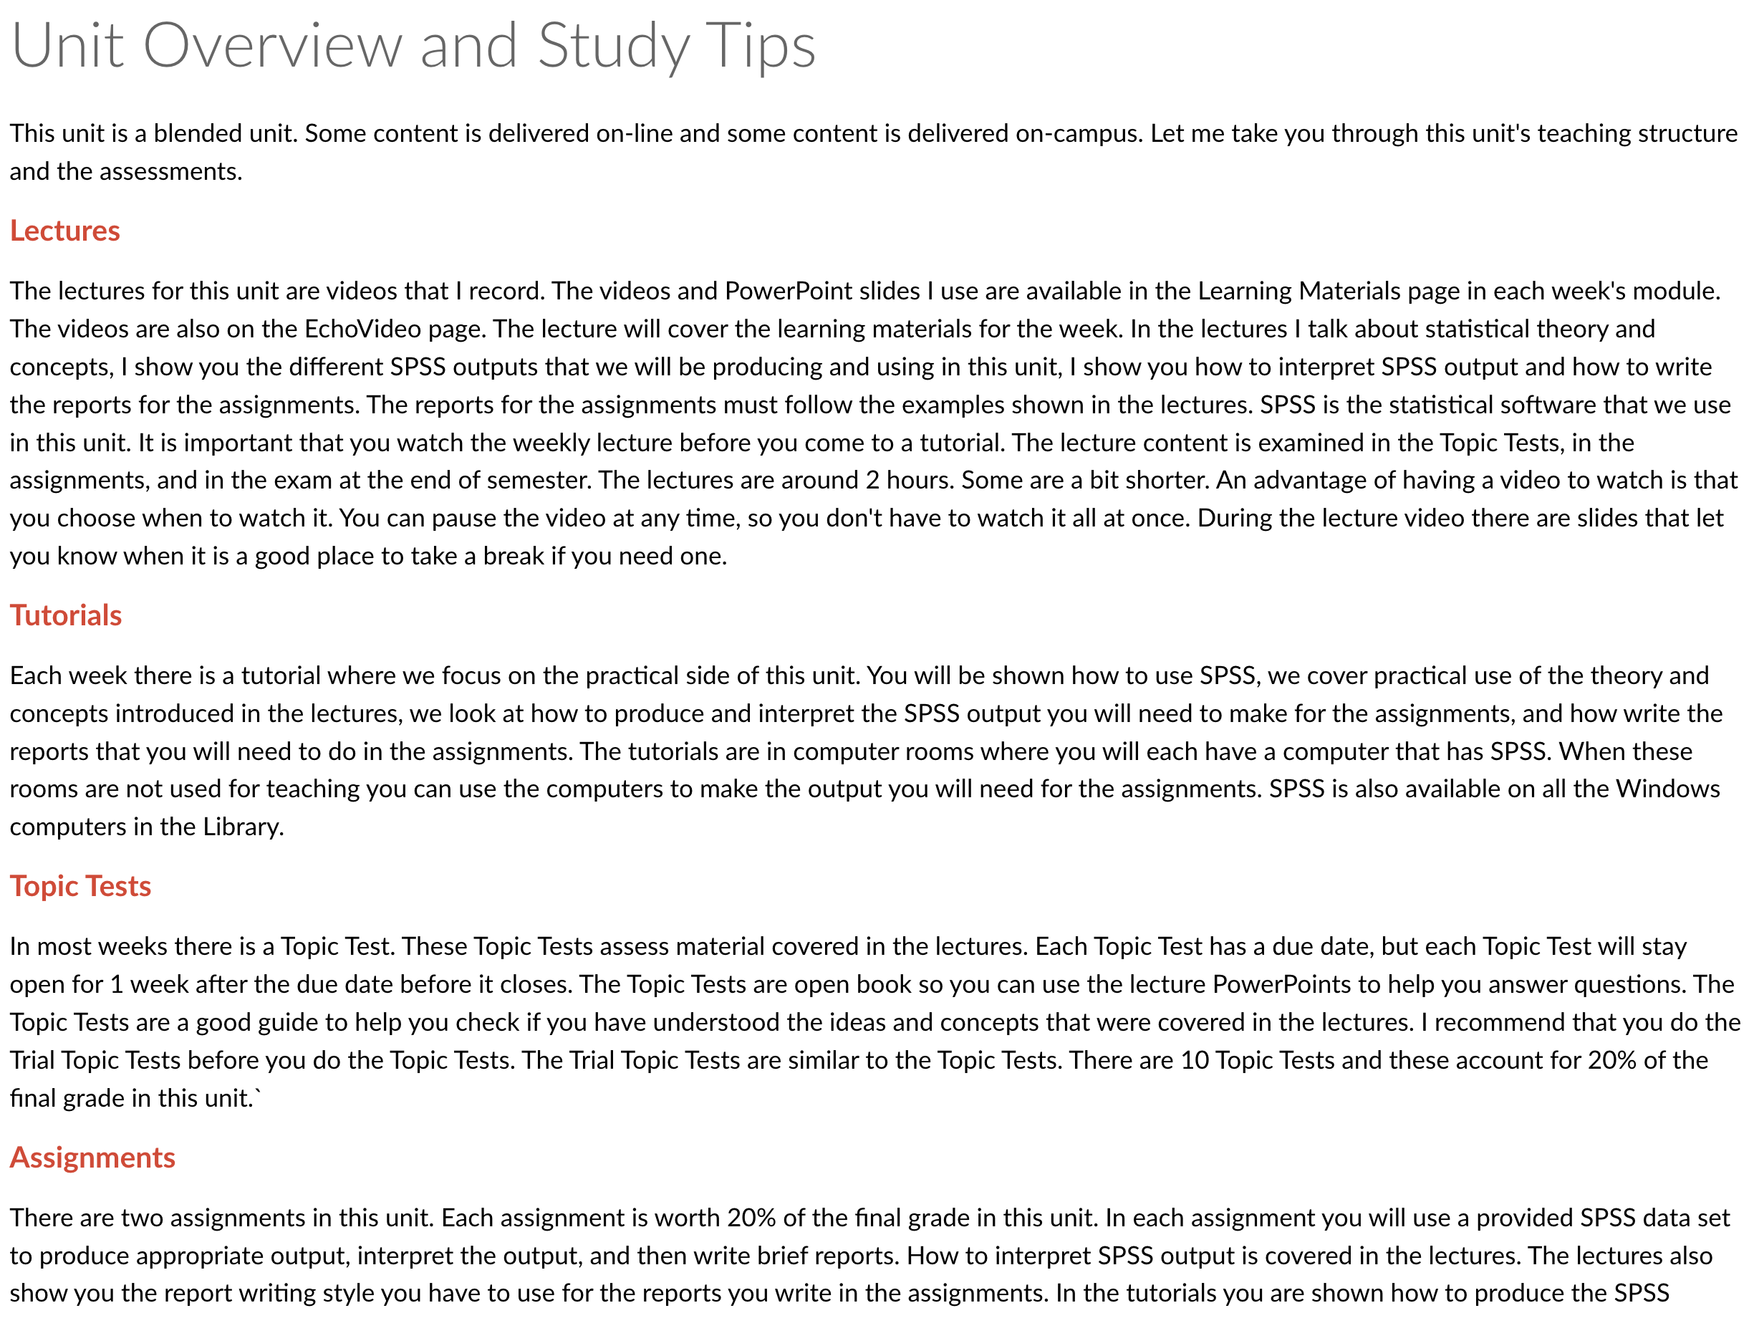

Slide 12
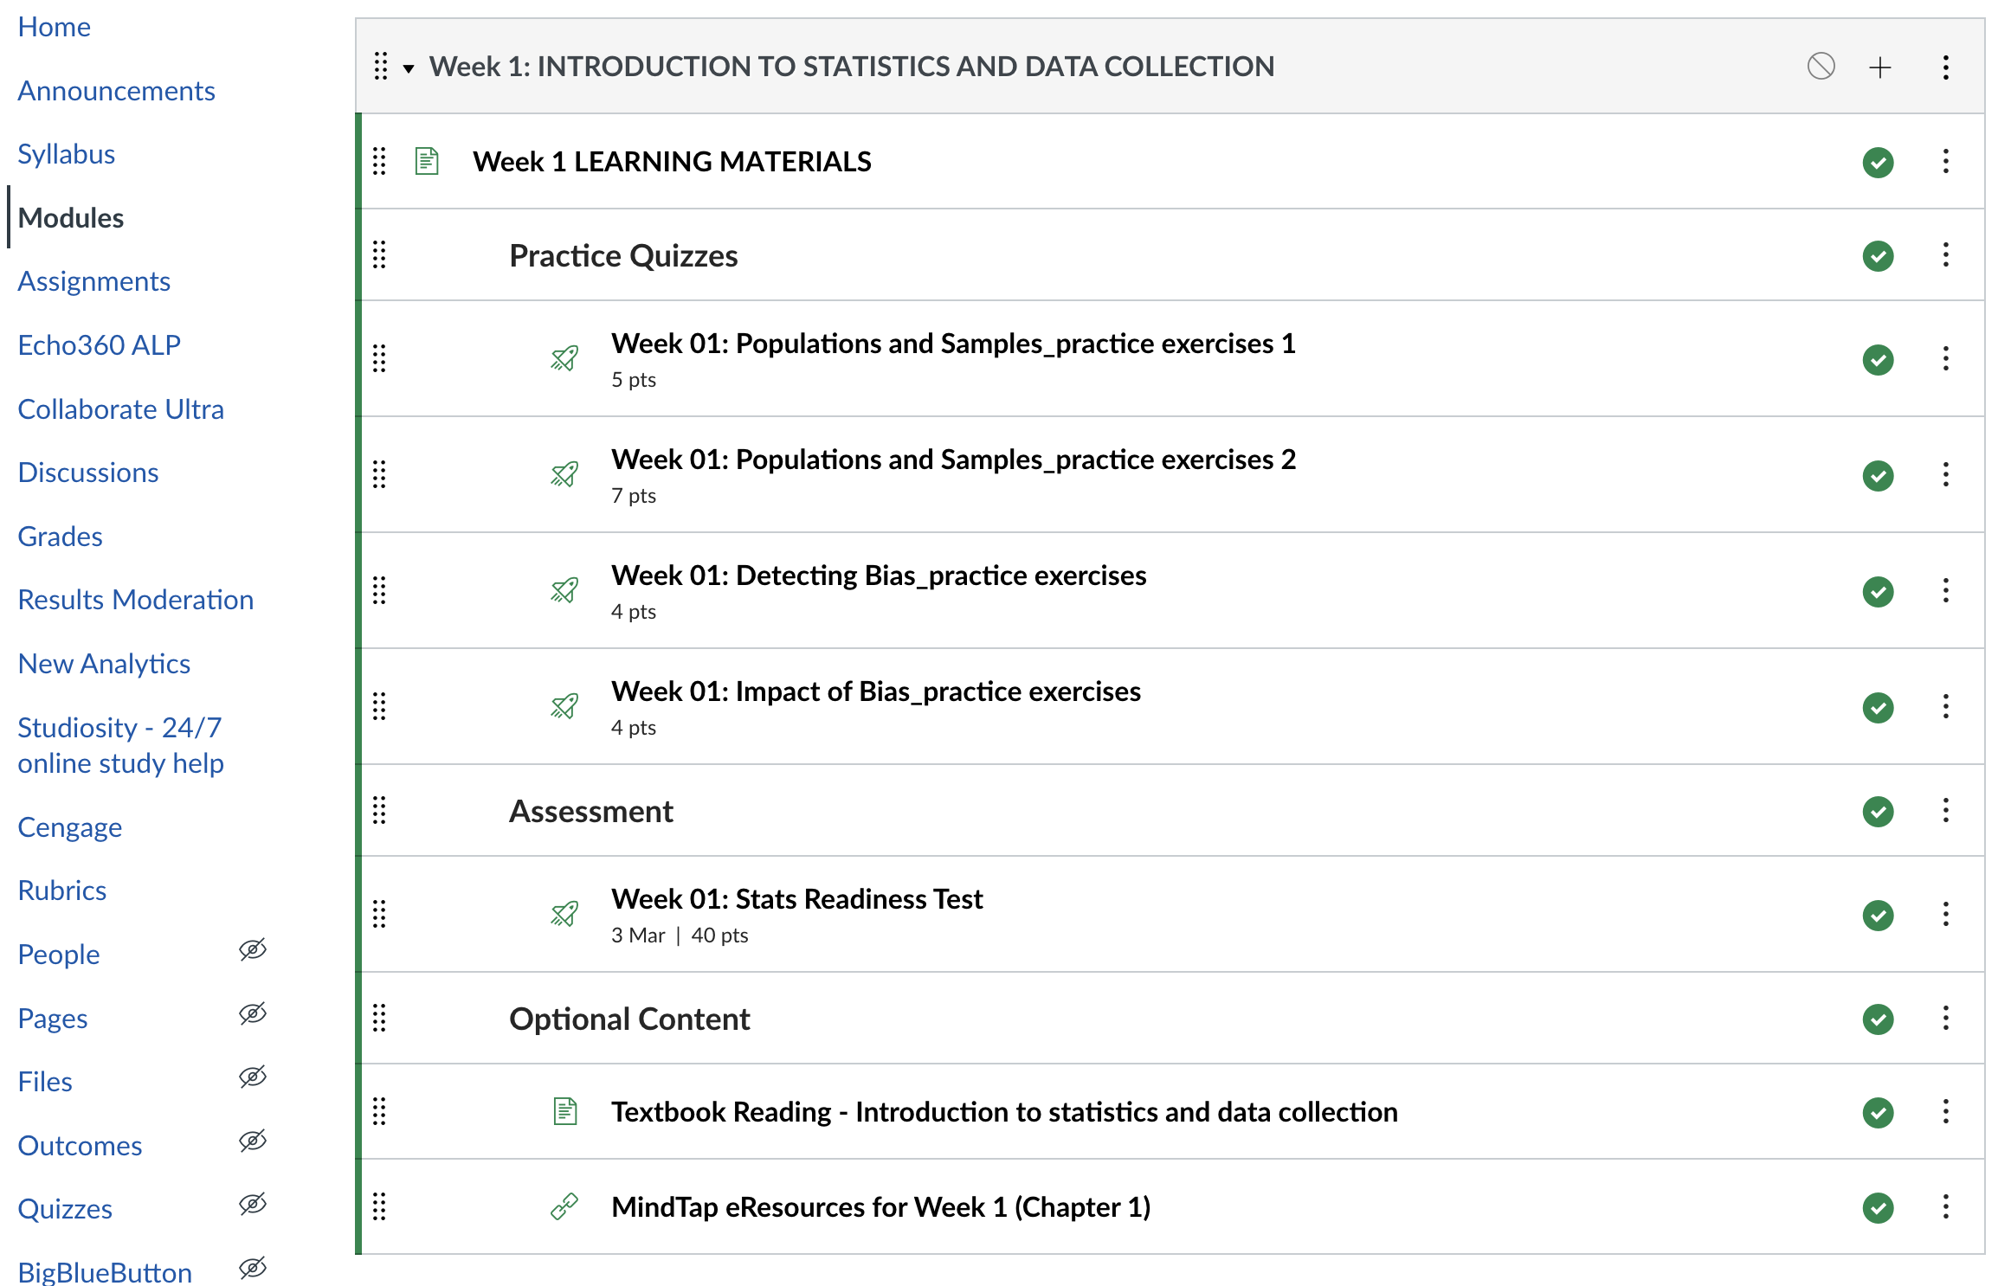

Slide 13
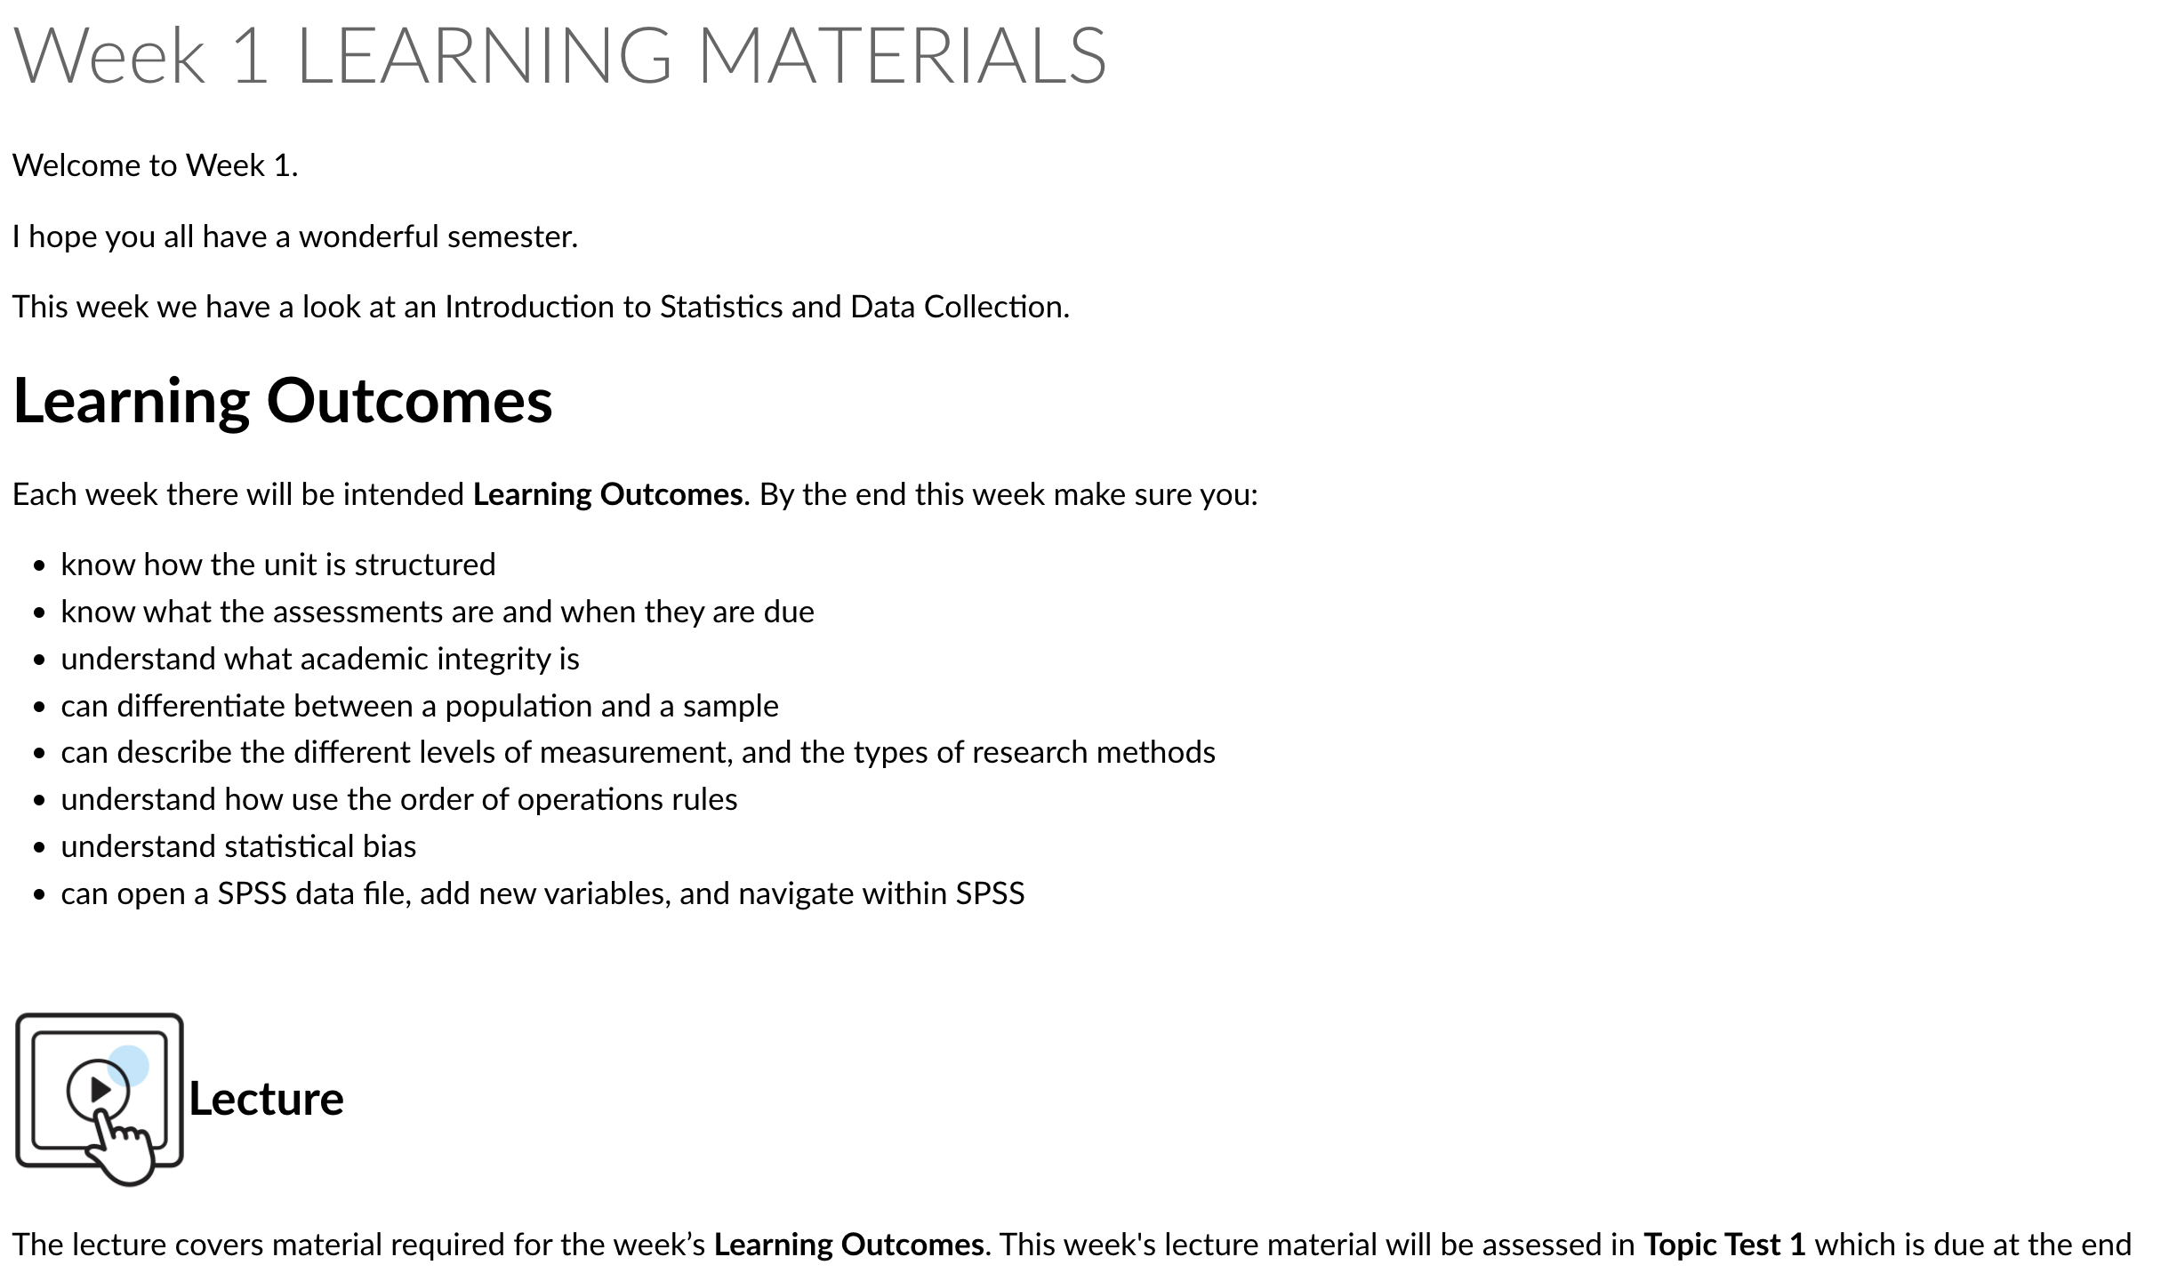

Slide 14
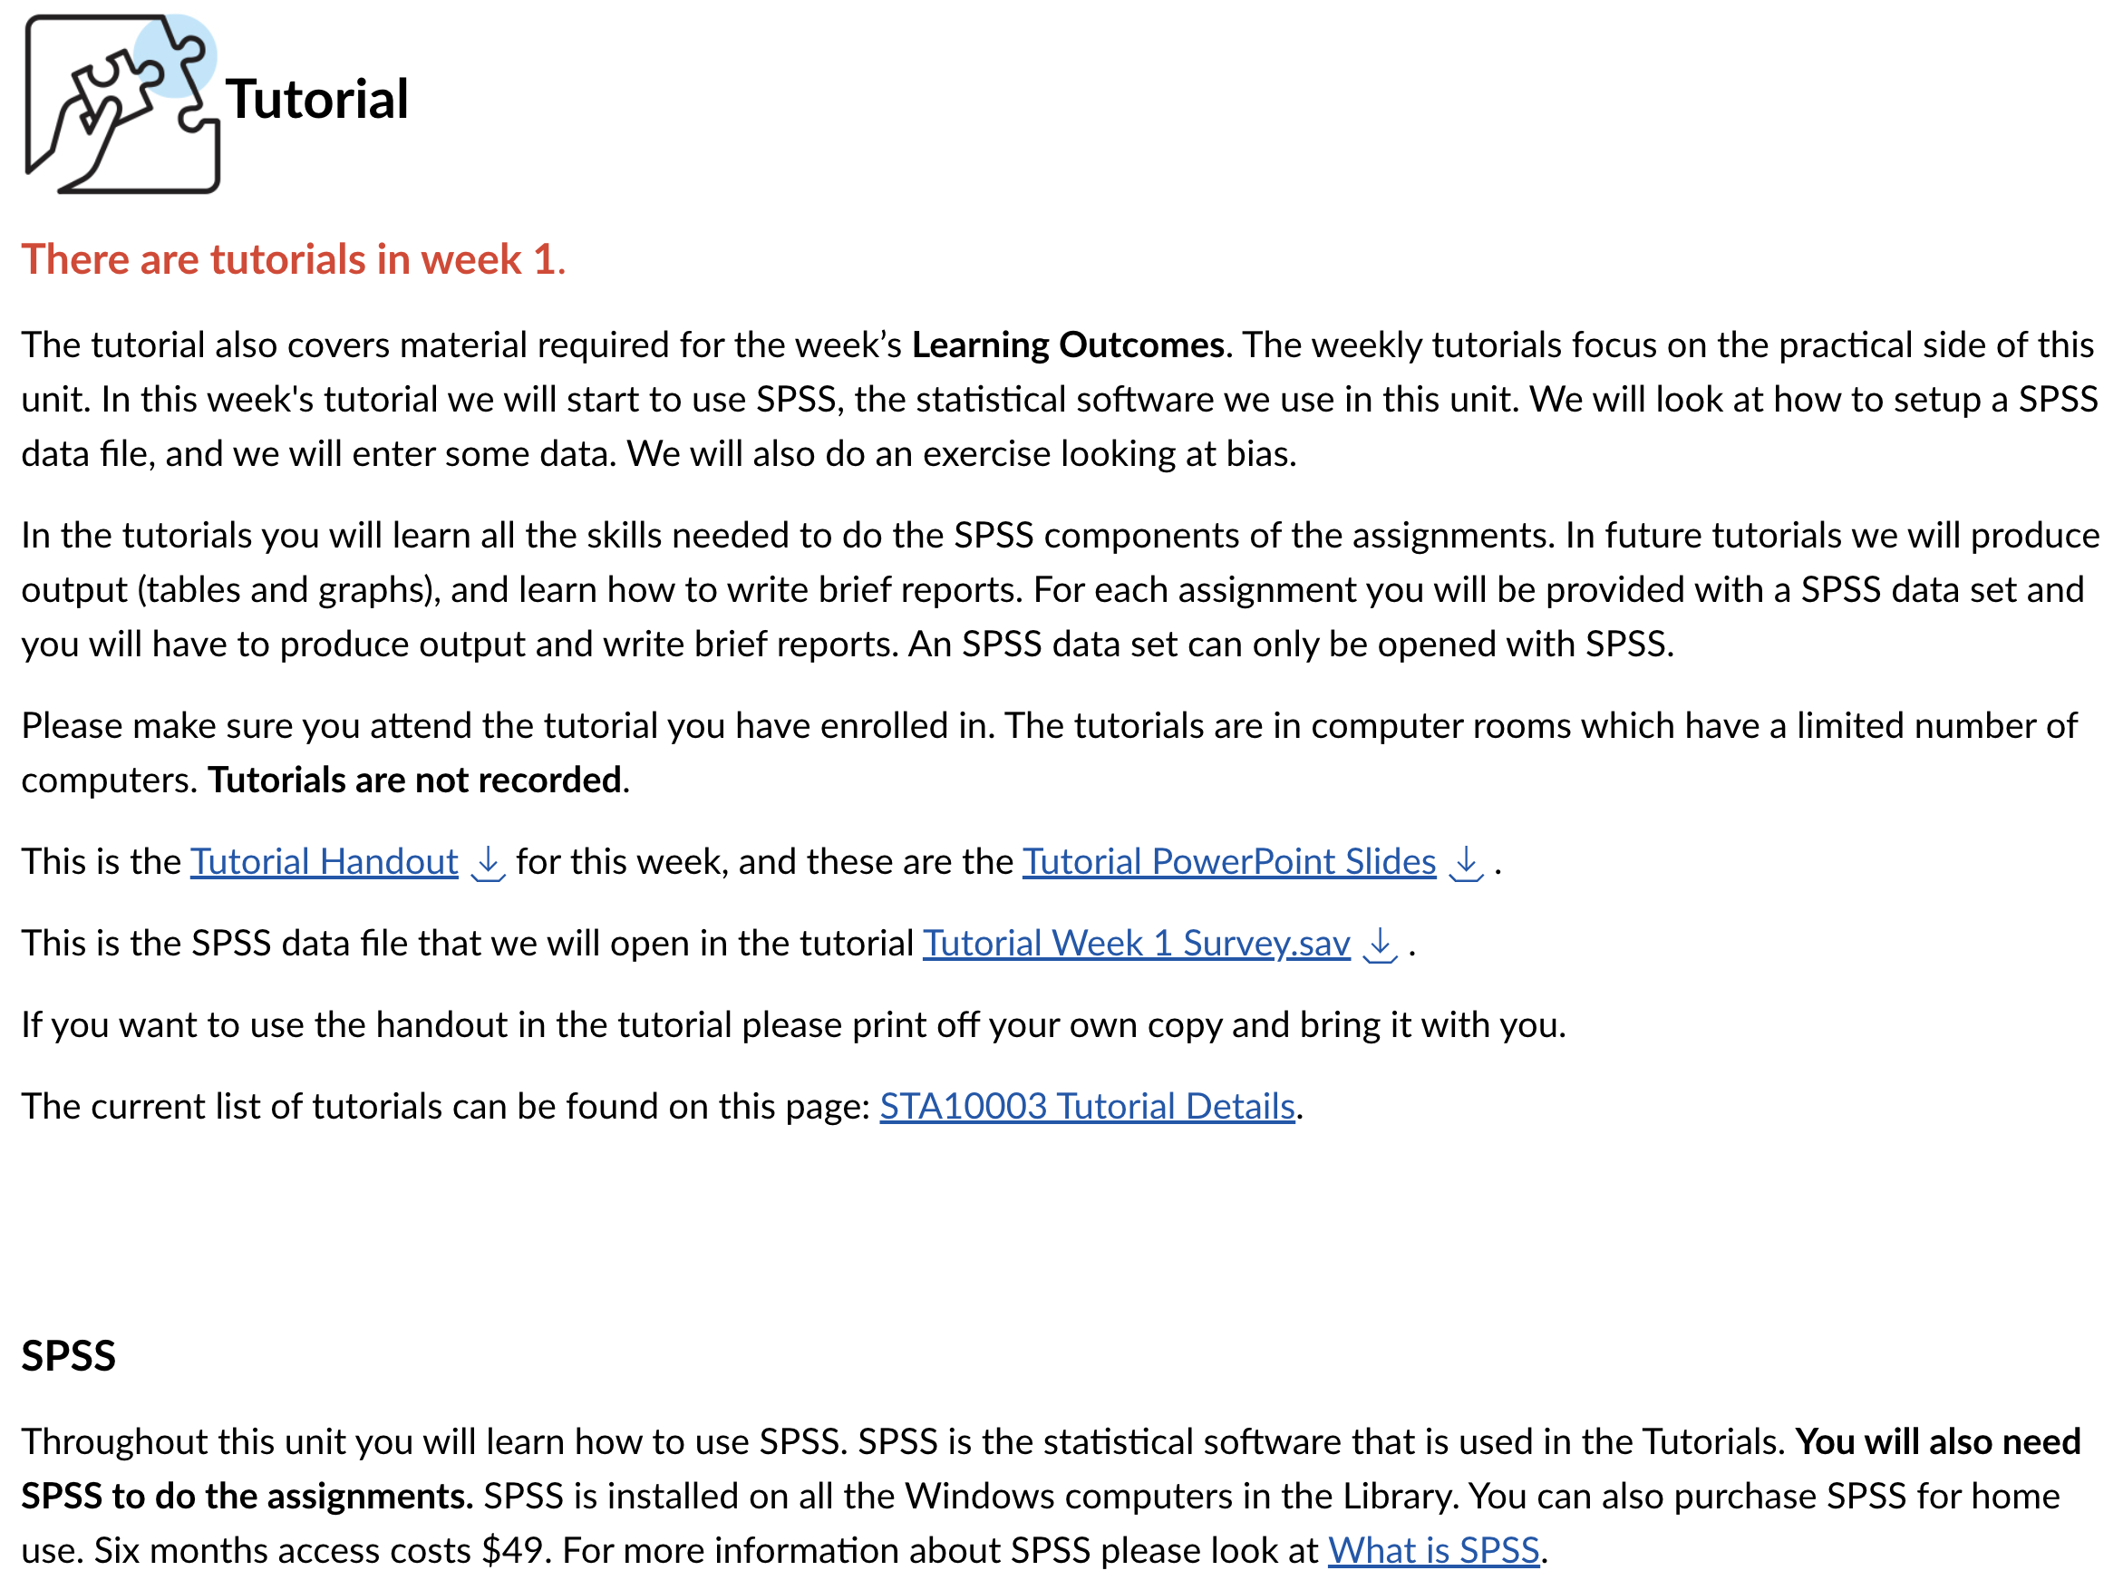

Slide 15
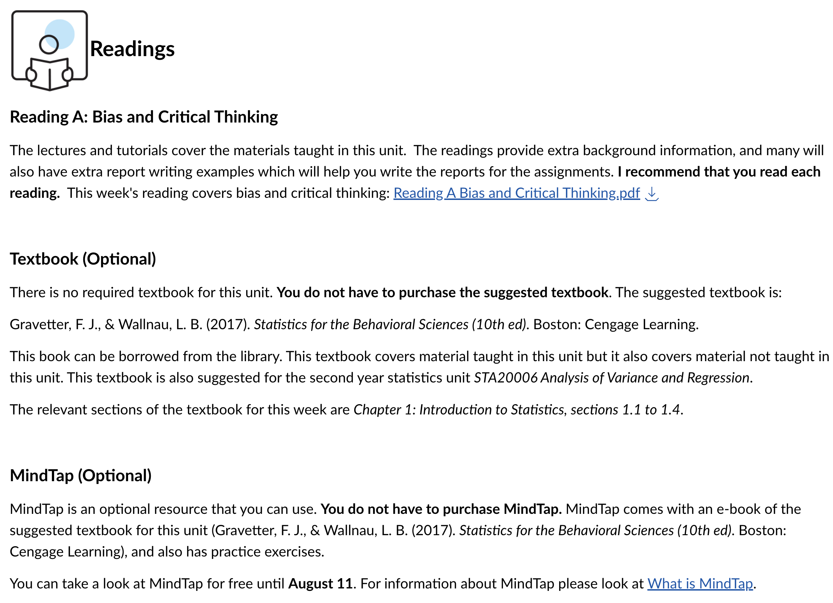

Slide 16
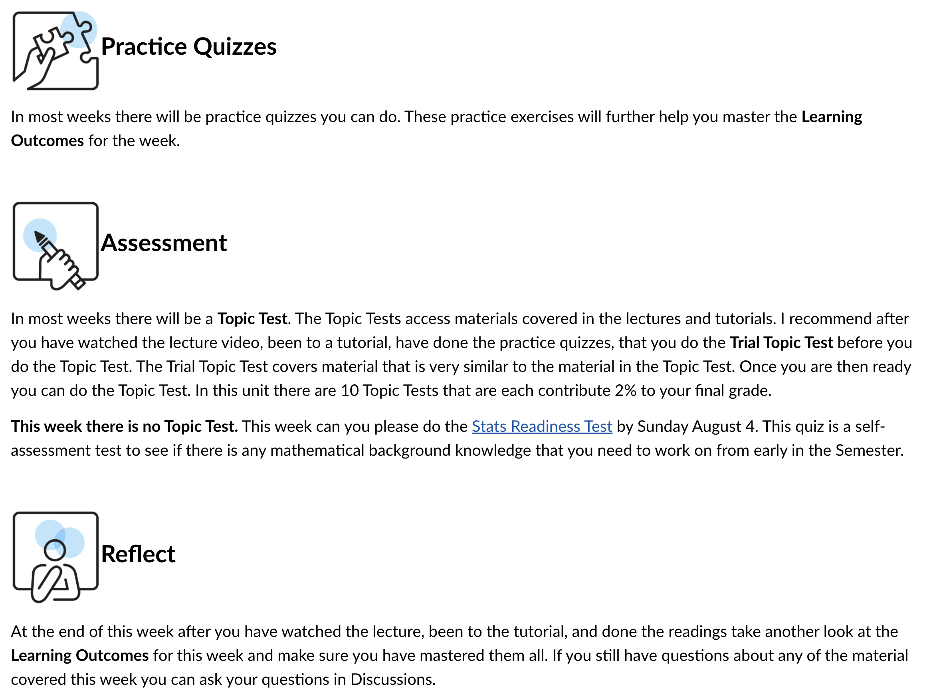

Slide 17
UNIT INFORMATION / HOUSEKEEPING
Assessments:
Statistics Readiness Test 0%
Topic Tests 20%
There are set due dates. Topic Test closes one week after due date
Assignment Part 1 20%
Assignment Part 2 20%
Final Assessment Quiz 40%
During examination period

Slide 18
UNIT INFORMATION / HOUSEKEEPING
Statistics Readiness Test 0%
This is a self-assessment test to see if there is any mathematical background knowledge that you need to work on early in the semester
Modules tab > Week 1 or Assignments
‘Statistics Readiness Test’

Slide 19
UNIT INFORMATION / HOUSEKEEPING
Topic Tests 20%
10 Topic Tests: each worth 2% of unit overall mark
Some Topic Tests will need you to interpret SPSS output
Trial Topic Tests [similar questions] to the actual Topic Test
Completed online / check Weekly Schedule in Unit Outline for Due Dates

Slide 20
UNIT INFORMATION / HOUSEKEEPING
Assignment 40%
Part 1 due: 20%
Part 2 due: 20%
The Assignment involves analysis of a data set using SPSS and providing written descriptions of the results of your analysis
Submitted via the Turnitin link [Assignments tab]
The Assignment and instructions will be available in the Assignment Information area
A Practice Assignment for Part 1 for the SPSS component is available. I suggest doing this after week 4.

Slide 21
UNIT INFORMATION / HOUSEKEEPING
Final Assessment Quiz 40%
During the Final Assessment Period
This is done in Canvas like a Topic Test.
It is open book and is timed.

Slide 22
Academic Integrity
Academic integrity is about taking responsibility for your learning and submitting work that is honestly your own. The use of generative AI is not allowed.
Plagiarising, cheating and seeking an unfair advantage with regards to an exam or assessment are all breaches of academic integrity and treated as academic misconduct.
Plagiarism is submitting or presenting someone else’s work as though it is your own without full and appropriate acknowledgement of their ideas and work.

Slide 23
Academic Integrity
using the whole or part of somebody else’s written work in an essay or other assessable work, including material from a book, journal, newspaper article, a website or database, a set of lecture notes, current or past student’s work, or any other person’s work
poorly paraphrasing somebody else’s work
submitting assessments that have been written by another person or service (paid or unpaid), often referred to as contract cheating

Slide 24
Academic Integrity
Swinburne encourages students to talk to staff, fellow students and other people who may be able to contribute to a student’s academic work but where an independent assignment is required, the work must be the student’s own
enabling others to plagiarise or cheat, including letting another student copy your work or by giving access to a draft or completed assignment
The penalties for academic misconduct can be severe, ranging from a zero grade for an assessment task through to expulsion from the unit and, in the extreme, exclusion from Swinburne.

Slide 25
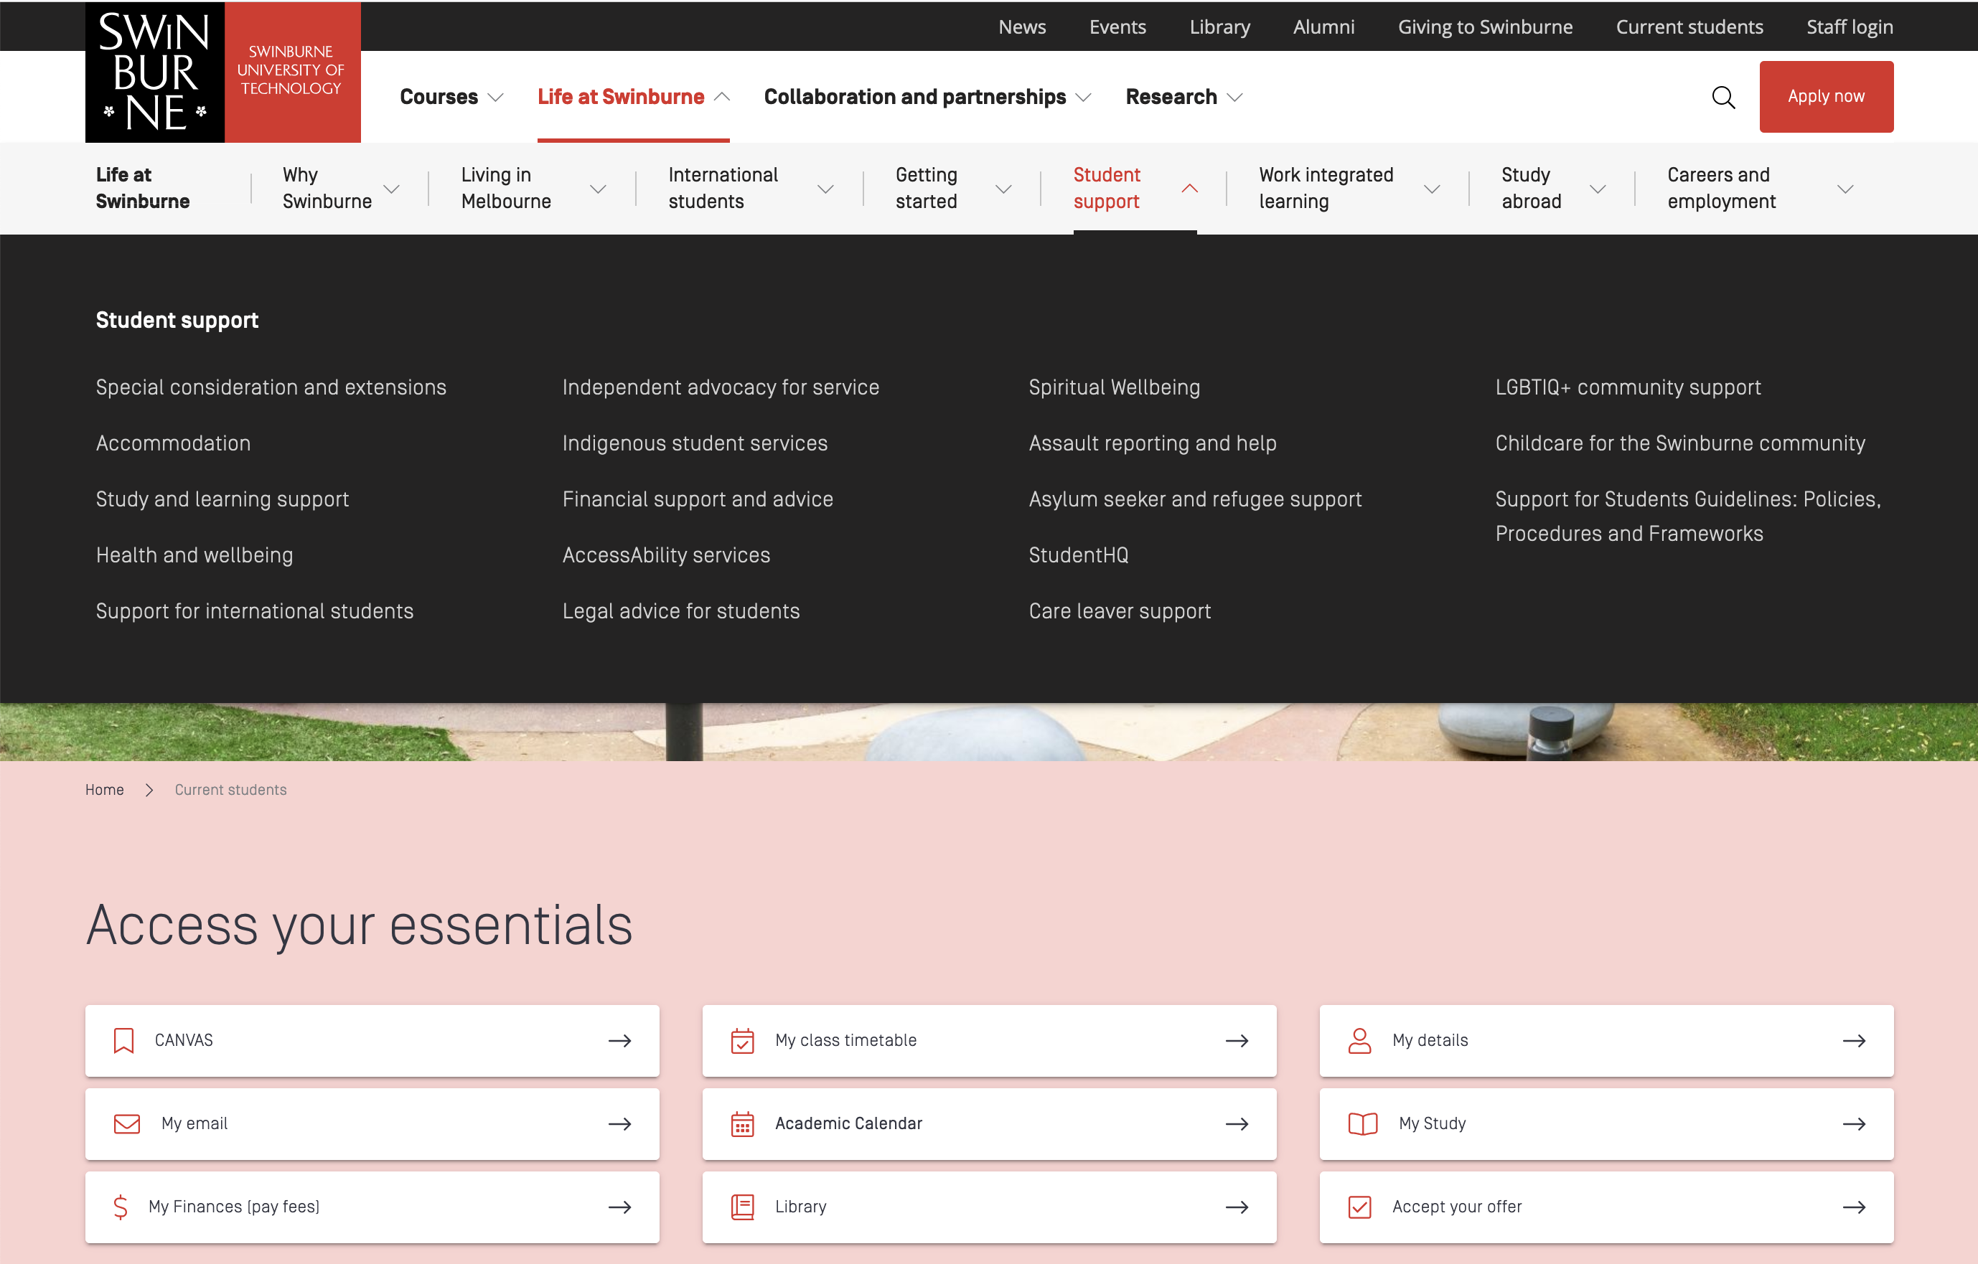
UNIT INFORMATION / HOUSEKEEPING
Support:
Study Group starts in Week 3

Slide 26
UNIT INFORMATION / HOUSEKEEPING
You will need to do additional work outside of the lecture / tutorial contact hours!
Refer to the Weekly Schedule so that you are aware of assessment due dates
It is extremely important that you keep up with the materials in this unit – it can be difficult to ‘catch up’ …

Slide 27
NEXT: Part 2 Terminology
PAUSE

Slide 28
Part 2: Terminology
STA10003 Week 1

Slide 29
TERMINOLOGY
‘Statistics’
used as an overarching term to include the procedures and techniques that are used to organise, summarise and interpret information collected
within ‘statistics’ further terminology is used to represent such things as populations, samples, variables …
Psychology example – Evaluate Anxiety Intervention, Before vs After, Male vs Female, Age, Different Interventions

Slide 30
TERMINOLOGY
Population:
All of the ‘things’ we are interested in
Can be people, households, car manufacturers, trains ...
Population parameter (describes entire population)
measurement value [size] of the population
Population of Venezuela
Population of Australian Households
Population of Victorian Households
Population of Trains
Population of Trains on the XYZ line
Difficult to measure the entire population …

Slide 31
TERMINOLOGY
Sample:
A subset of the population
Must be representative of the population if we want to infer [generalise] our finding to the population of ‘things’ [population of interest] Random sample from the population of interest
Sample statistic (describes sample)
Size of the sample
Mean / Median / Mode / Range / Standard Deviation
Samples may not always be representative of Populations. Population: Melbourne Metro Sample: Hawthorn residents

Slide 32
TERMINOLOGY
Variable:
Overarching label of the element / feature we want to measure – a variable must vary (not be the same for everyone)
Gender: Male / Female / Non-Binary / Other / Prefer not to say
Ethnicity: Country of Birth
Age: In actual years OR in age groups (<20, 20-24, 25-29, 30-34..)
Time of Week: Day of the week OR Weekdays / Weekends

Slide 33
TERMINOLOGY
Descriptive vs Inferential Statistics
Descriptive statistics:
Organises raw information into ‘manageable’ information
numerical and / or graphical form
students studying a particular course at a particular university; household size; the most popular type of vehicle
Inferential statistics:
Techniques that allow us to use sample statistics to generalise to [make conclusions about] the population
Hypothesis Tests; Confidence Intervals
Need to be aware of sampling error – natural discrepancy existing between the sample statistic and the population parameter. The sample statistic (mean) can provide us with an estimation of the population parameter (mean).

Slide 34
TYPES OF RESEARCH
Descriptive Research:
When we just want to find out ‘something’
Age of students studying this particular unit
Percentage of students studying full time [ie 3 or 4 units]
Correlational Research:
When we want to explore a relationship between two [or more] variables
Is there a relationship between height and weight?
Is there a relationship between study hours and employment hours?
Comparative Research:
When we want to compare two [or more] groups on the same measure
Do part-time students spend more hours working than full-time students?
Comparing the hours of work for the different groups

Slide 35
RESEARCH METHODS
Experimental Method:
Allows a cause-effect explanation
One variable [IV] is causing a change in the other [DV]
IV: Independent Variable - Predictor variable / Explanatory
DV: Dependent Variable - Outcome variable / Response variable
(Medication: Control 0mg, 5mg, 10mg)
(Pain reduction - mins)
The IV is manipulated [while other variables are held constant], and the DV is observed / measured

Slide 36
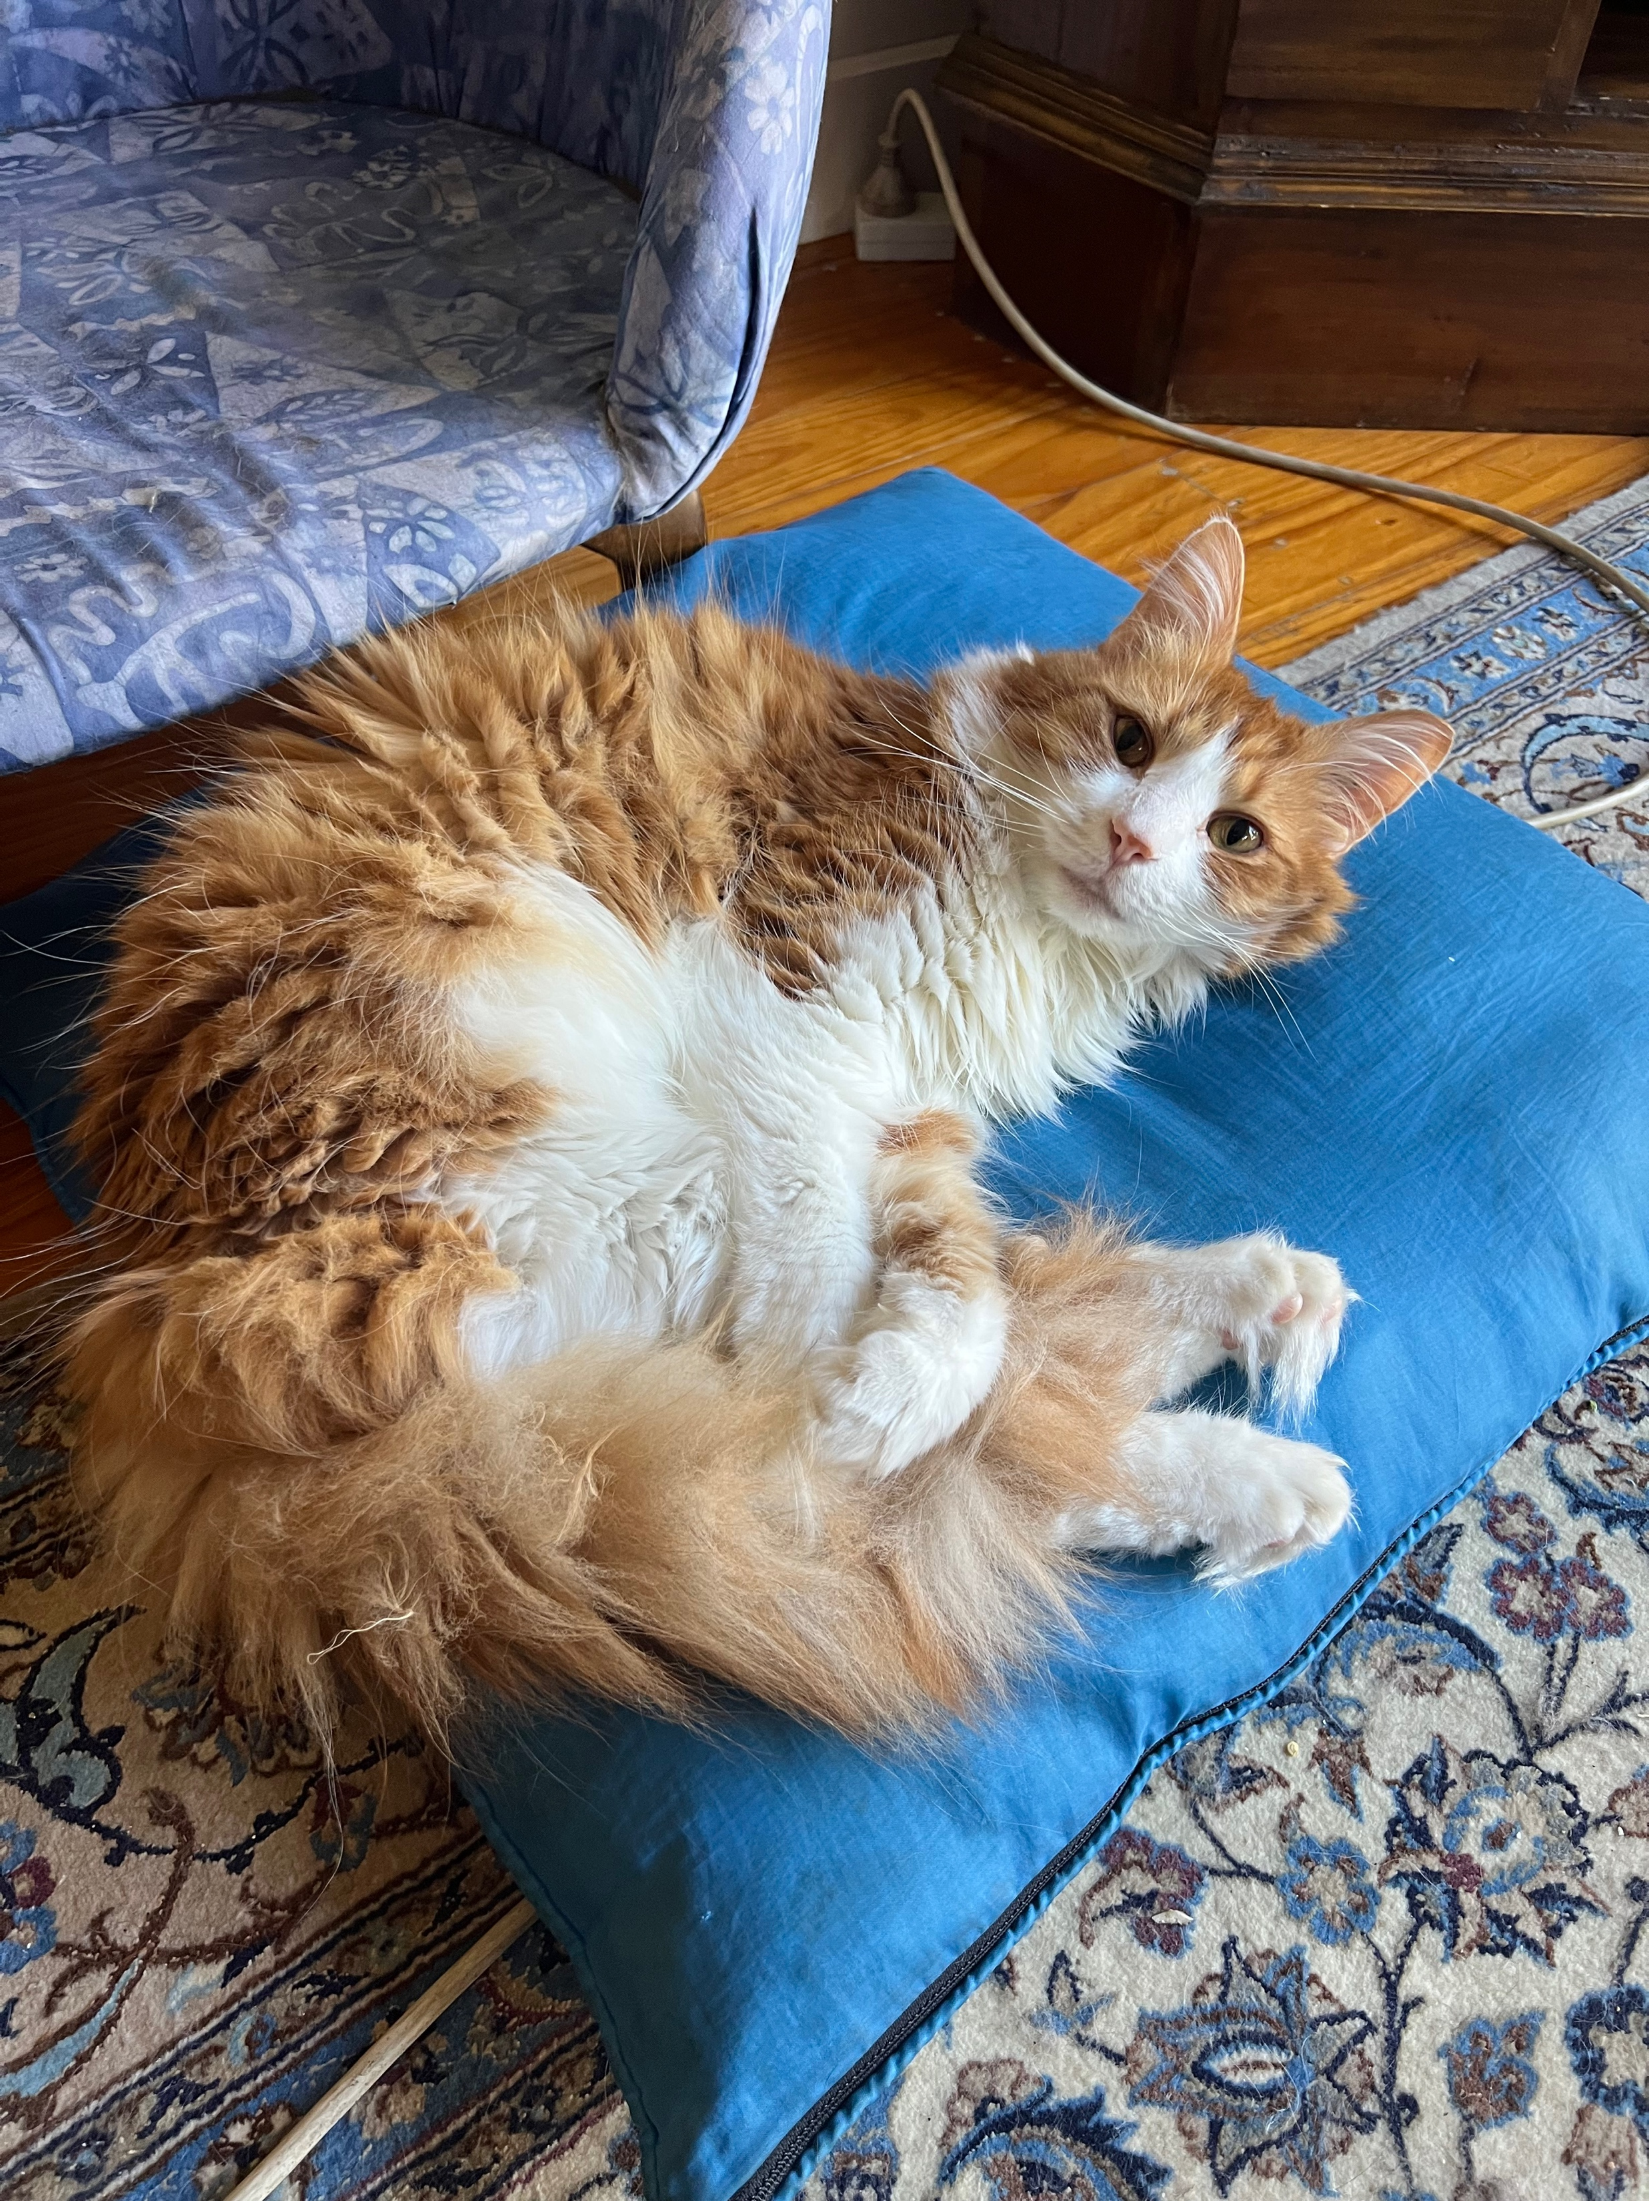
Fa February 19 2023

Slide 37
RESEARCH METHODS
Non-Experimental Method :
Does NOT allow a cause-effect explanation
Both variables are observed/measured
Correlational Research
Non-equivalent Groups (not random)
Pre-Post Studies
IV – Gender (male, female, other)
DV – Income ($/week)
Note: In non-experimental research, the IV is often called a ‘quasi-independent variable’ …

Slide 38
RESEARCH METHODS
Non-Experimental Method [cont]:
Correlational Research
Is there a relationship between height [IV] and weight [DV]?
Is there a relationship between study hours and employment hours?
Information is recorded only – no manipulation
Non-equivalent Groups
Comparing heights [DV] of males and females – Gender [IV]
Comparing the hours of work [DV] for part-time and full-time students
The IV is not manipulated
Pre-Post Studies
The DV is measured twice [at different times]
Comparing scores [DV] before and after completing competency training
Comparing weight [DV] prior to special diet, and after being on special diet for a period of time

Slide 39
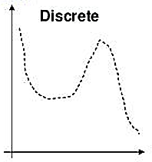
VARIABLES
Overarching label of the element / feature we want to measure Discrete or Continuous
Discrete variable:
Separate categories [no intermediate values between]
‘Countable’ number of values
Number of children
Number of test questions answered correctly
Blood type
Discrete / Continuous: Applies to the measure rather than the scores obtained

Slide 40
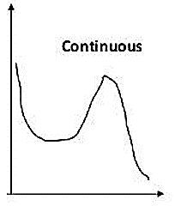
VARIABLES
Overarching label of the element / feature we want to measure Discrete or Continuous
Continuous variable:
Infinite number of values that fall between two observed / measurable values
Divisible into an infinite number of fractional parts
Age! 25 years
… 25 years, 19 days, 3 hours …
Distance travelled
Speed of aircraft
Discrete / Continuous: Applies to the measure rather than the scores obtained

Slide 41
MEASUREMENT OF VARIABLES
Scales of Measurement:
Categorical: Nominal & Ordinal
Nominal: | used to label [name] the group eg 1 = Male 2 = Female 3 = Other 4 = Prefer not to say
Ordinal: | used to label AND order eg 1st, 2nd, 3rd, 4th in a race, Chapter 1, Chapter 2, Chapter 3 in Text
Metric: Interval & Ratio
Interval: | numbers are used to label and order AND the intervals between the numbers are equal eg Temperature in ⁰ C or ⁰ F
Ratio: | numbers are used to label and order and the intervals between the numbers are equal AND ZERO means a complete absence of something eg number of correct answers in a test
The different scales of measurement determine what statistical procedures / techniques are appropriate for the data collected

Slide 42
STATISTICAL NOTATION
Population: N
Population parameter [number of scores in the population]
N represents the population size
Population of Venezuela N = 32,674,532
Population of Australian Households N = 8,286,084
Population of Victorian Households N = 2,112,706
Population of Trains N = ???
Population of Trains on the XYZ line N = ???
Sample: n
Sample statistic [number of scores in the sample]
n represents the sample size
Sample from the Population of Venezuela n = 100,000
Sample from the Population of Australian Households n = 10,000
Sample from the Population of Victorian Households n = 2,000
NOTE: SPSS uses N for sample size as it does not know if you are analysing a population or a sample

Slide 43
STATISTICAL NOTATION
Raw scores: X
original, unchanged scores obtained from the data collection
Typically represented by X
If two variables, then X measures one variable and Y measures the other. X = weight / Y = height
Summing scores: Σ
When adding scores, the Greek letter Σ (Sigma) is used to designate summation
ΣX means to add all the X values
ΣY means to add all the Y values
Hand Calculations:
Suppose we have scores of: 2, 1, 9, 4
ΣX: 2 + 1 + 9 + 4
ΣX = 16

Slide 44
ORDER OF OPERATIONS
When there are more expressions in the equation [eg multiplication, squaring …], things can seem more confusing
The summation process can be ‘simplified’ by following the sequence or order in which calculations should occur. Five steps:
Any calculation in parentheses [brackets] is done first
Squaring is done second
Multiplication or division in done third – if more than one they are done in order from left to right
Summation [Σ] is fourth
Any other addition / subtraction is the final step

Slide 45
ORDER OF OPERATIONS
Worked example using the values of 2, 1, 9, 4:
Any calculation in parentheses [brackets] is done first
Squaring is done second
Multiplication or division in done third – if more than one they are done in order from left to right
Summation [Σ ] is fourth
Any other addition / subtraction is the final step
ΣX²
[Note, no parentheses so squaring is completed first, then summation]
2² + 1² + 9² + 4²
4 + 1 + 81 + 16
ΣX² = 102

Slide 46
ORDER OF OPERATIONS
Worked example using the values of 2, 1, 9, 4:
Any calculation in parentheses [brackets] is done first
Squaring is done second
Multiplication or division in done third – if more than one they are done in order from left to right
Summation [Σ ] is fourth
Any other addition / subtraction is the final step
(ΣX)²
[calculation with parentheses is completed first, then squaring]
2 + 1 + 9 + 4 = 16
16²
(ΣX)² = 256

Slide 47
ORDER OF OPERATIONS
Worked example using the values of 2, 1, 9, 4:
Any calculation in parentheses [brackets] is done first
Squaring is done second
Multiplication or division in done third – if more than one they are done in order from left to right
Summation [Σ ] is fourth
Any other addition / subtraction is the final step
Σ(X + 1)
[calculation with parentheses is completed first, then summed]
(2 + 1) + (1 + 1) + (9 + 1) + (4 + 1)
3 + 2 + 10 + 5
Σ(X + 1) = 20

Slide 48
ORDER OF OPERATIONS
Worked example using the values of 2, 1, 9, 4:
Any calculation in parentheses [brackets] is done first
Squaring is done second
Multiplication or division in done third – if more than one they are done in order from left to right
Summation [Σ ] is fourth
Any other addition / subtraction is the final step
Σ(X + 1)² [calculation with parentheses is completed first, then squaring, then add]
(2 + 1) + (1 + 1) + (9 + 1) + (4 + 1)
3² + 2² + 10² + 5²
9 + 4 + 100 + 25
Σ(X + 1) ² = 138

Slide 49
It is good practice to work through some hand calculations …
SPSS will be doing many of the calculations for us, but it is useful to understand what the process involves.

Slide 50
NEXT: Part 3 Critical Thinking in Statistics
PAUSE

Slide 51
Part 3: Critical Thinking in Statistics
STA10003 Week 1

Slide 52
CRITICAL THINKING IN STATISTICS
Statistics in every day life
Media Reports
Drink-Driving Laws
Covid-19
Statistics are credible – aren’t they?
Scientific sounding
Used by experts
Research suggests that 82% of first year university students “hate statistics”.
Research suggests that 82% of first year university students “love statistics”.

Slide 53
BIAS
What is bias?
Any effect that makes our results non-representative
Two main forms of bias
Selection Bias:
Occurs when the sample selected does not truly represent the population of interest
Random sampling of the population of interest can help eliminate sampling bias
Information Bias:
Refers to how the information was collected / measured
Need to be careful of question wording, etc.

Slide 54
SELECTION BIAS
We are interested to find out ‘something’ about all Swinburne employees.
A random sample of staff in the School of Health Sciences is taken and asked a particular question about ‘something’
Is this sample selection biased or unbiased?
Why / Why not?

Slide 55
SELECTION BIAS
We are interested to find out ‘something’ about all Swinburne employees.
A random sample of staff at the University is taken and asked a particular question about ‘something’
Is this sample selection biased or unbiased?
Why / Why not?

Slide 56
INFORMATION BIAS
Consider the statement:
“Every year since 1950 the number of American children gunned down has doubled”
1950 – 100 Children
1960 – 102’400 Children
1980 – 107’374’182’000 Children (107 Billion)
1980 Population USA 226.5 million

Slide 57
INFORMATION BIAS
The original wording of this statement:
“The number of American children killed each year by guns has doubled since 1950 ”
from the Children’s Defense Fund (CDF )
Source: Best, J. (2001). Damned Lies and Statistics, University of California Press: CA, US
Think critically!
Be careful of misleading stats!

Slide 58
INFORMATION BIAS
Emotive Language:
It is intolerable that refugees should be subjected to the appalling conditions in refugee centres. Agree or disagree?
Leading Question:
How dumb is [insert your choice of politician’s name here] when it comes to government policy?
Most people don’t want to work for more than 30 hours a week. What do you have to say about it?

Slide 59
INFORMATION BIAS
Double-barrelled Question:
When was the last time you purchased a house or a car?
Unclear Question:
Do you think that FAC [or any other acronym] meetings should be shorter?

Slide 60
INFORMATION BIAS
Answering Responses:
The Trump ‘Make America Great Again’ Committee asked respondents to ‘cut through the media’s noise’ and rate the first years of Presidents Trump and Obama …
How would you rate:
President Trump’s first year in office [2017?] | President Obama’s first year in office [2009?]
Great Good Okay Other | Great Good Okay Poor Other

Slide 61
INFORMATION BIAS
Source of Study / Who conducted the Study:
Dandruff shampoo company tells us that their product is the best!
Coke tastes better than Pepsi! [survey undertaken on behalf of CocaCola Company]
Television / Newspaper / Online Polls

Slide 62
IDENTIFYING POSSIBLE SOURCES OF BIAS IN A STUDY:
How were the individuals / objects in the study selected?
What measurements were made? What questions were asked?
Who conducted / sponsored the study?

Slide 63
AVOIDING BIAS
Sample should be randomly selected where possible from the population of interest
Non-leading language in question wording
Source should be reliable / credible
If there is any bias, we cannot conclude anything meaningful about the population of interest from looking at the sample!
Whenever we take a sample, we would like to infer our findings to the population.
Be on the lookout for potential bias!!

Slide 64
Jackson & Jackson manufacture adhesive bandages in boxes of 50 units. The Quality Control Manager is concerned that the machine packaging the bandages may be faulty, and she wants to estimate the percentage of boxes that do not contain the correct quantity of bandages.
She takes a sample of 400 boxes from the last production run on a particular day and finds that 26 boxes do not contain the correct quantity of bandages.
Notes:
So, the QC Manager wants to find out some information – based on this sample …

Slide 65
What is the population the Quality Control Manager interested in?
All bandages
All 400 boxes of bandages in the sample
All boxes of bandages produced by Jackson & Jackson
All people who use bandages
The information collected from this sample is:
Probably biased
Probably unbiased
Notes:
All boxes of bandages produced by Jackson & Jackson [we only have information from this particular company]
A. Probably biased, because of the way he selected the sample. This was a convenience sample [taken from the last production run so they were readily available].

Slide 66
If 26 boxes from the sample of 400 boxes do not contain the correct quantity of bandages [6.5%], what can we conclude from this sample statistic?
We cannot say anything meaningful about the percentage of boxes of bandages that do not contain the correct quantity
The percentage of boxes of bandages with an incorrect quantity is 6.5%
A low percentage of boxes of bandages contain an incorrect quantity, but it may not be exactly 6.5%
Notes:
6.5% [26 / 400 = 0.065]
So what can we conclude? Our conclusion is based on the population, so what can we say about the population of bandages produced by Jackson & Jackson?
A. Cannot say anything meaningful because of the way the sample was collected ...

Slide 67
Jackson & Jackson manufacture adhesive bandages in boxes of 50 units. The Quality Control Manager is concerned that the machine packaging the bandages may be faulty, and they want to estimate the percentage of boxes that do not contain the correct quantity of bandages.
They take a random sample of 400 boxes from a variety of production runs over a one month period to calculate the proportion of boxes that do not contain the correct quantity of bandages per box.
Notes:
Okay, so the first part of this scenario is the same as the previous example – BUT this time the sample selection differs ...

Slide 68
The information collected from this sample is:
Probably biased
Probably unbiased
If 25 of the 400 boxes do not contain the correct quantity of bandages [6.3%], what can we conclude from this sample statistic?
We cannot say anything about the percentage of boxes of bandages that do not contain the correct quantity
6.3% of boxes of bandages contain an incorrect quantity
A low percentage of boxes of bandages contain an incorrect quantity, but it may not be exactly 6.3%
Notes:
Probably unbiased as a random sample over various time periods have been selected.
C. A low percentage of boxes of bandages contain an incorrect quantity, but it may not be exactly 6.3%

Slide 69
Now What?
Learning Outcomes
Each week there will be intended Learning Outcomes. By the end this week make sure you:
know how the unit is structured
know what the assessments are and when they are due
understand what academic integrity is
can differentiate between a population and a sample
can describe the different levels of measurement, and the types of research methods
understand how use the order of operations rules
understand statistical bias
can open a SPSS data file, add new variables, and navigate within SPSS
Attend the Weekly Tutorial

Slide 70
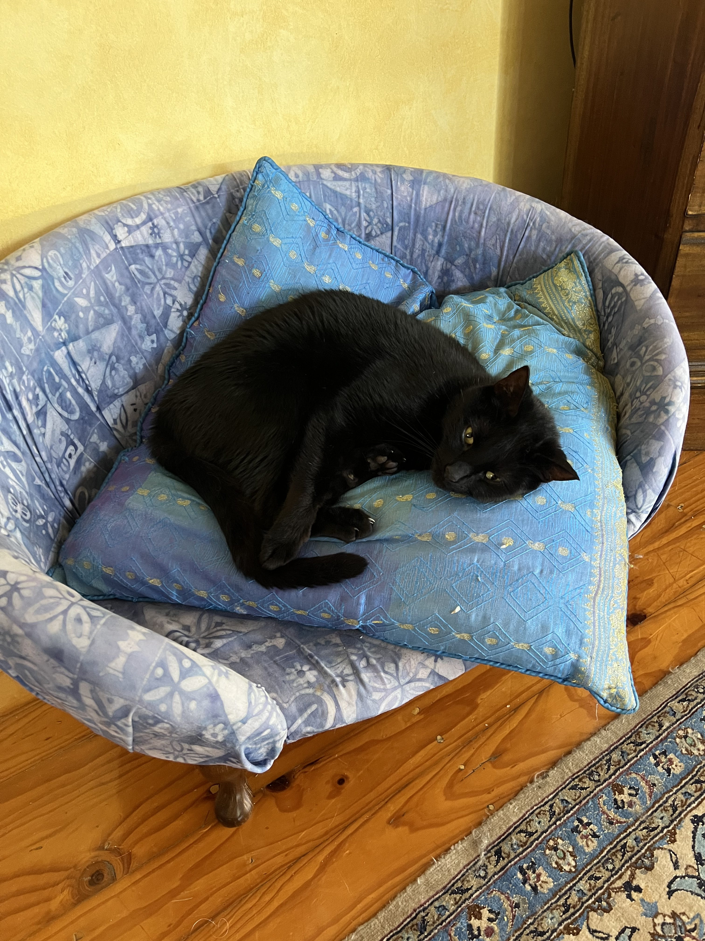
Bombay January 26 2023

